Slide 1
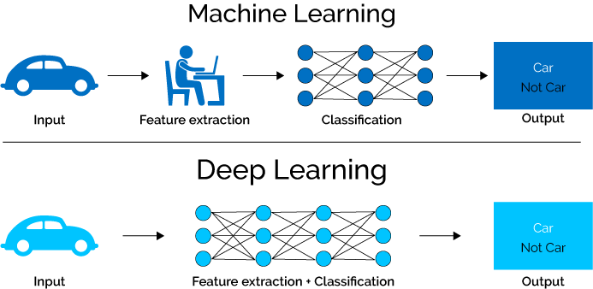
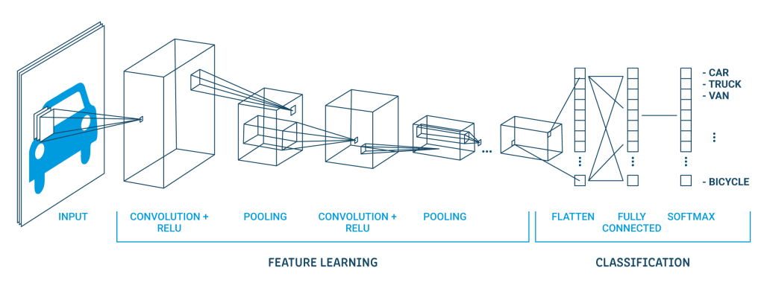
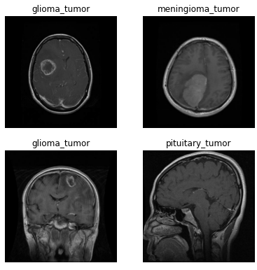
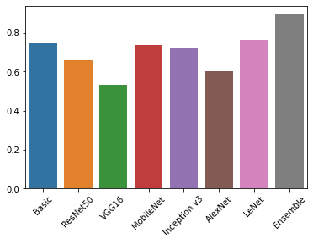


Classification MRI images for brain tumour identification using CNN
Introduction
In UK alone, around eleven thousand primary brain tumour patients are diagnosed each year. The number of secondary tumour patients is even larger. Early detection of the tumours are essential for successful treatment. In many developing countries, because of lack of specialised doctors, patients have to travel to remote urban areas for consultation with doctors. This acts as a hindrance that may delay diagnosis. However, in many such places, the medical centres may have access to Magnetic-Resonance Imaging (MRI) systems operated by laboratory technicians. In this project, we develop a system that can be used by such technicians to upload images of MRI scans of the brain, and obtain preliminary diagnosis.
Examples of MRI scans identifying various tumours
Related Work
Traditionally, researchers have used image processing techniques to preprocess the images to identify region of interest (RoI) from where they extracted desired features (e.g., histogram-based, wavelength-based features, etc.). These features were used with machine learning algorithms to perform prediction. Others used Content-Based Image Retrieval systems to obtain metadata associated with similar images as the input image and perform prediction using the metadata. The development of Convolutional Neural Network (CNN) has allowed the development of end-to-end architectures that can allow us to perform prediction without requiring any pre-processing.
Methodology
In this project, we will use an ensemble of seven state-of-the-art CNN architectures to perform prediction on the MRI images. CNN are artificial neural networks, especially suitable for image analysis, which perform feature extraction using a series of convolutional and pooling layers, before using a fully-connected network to perform prediction. The architectures chosen for this project are BasicNet, LeNet5, AlexNet, ResNet50, MobileNet, InceptionNet(v3), and VGG16. The reason behind using an ensemble method is to mitigate the errors that in a single model.
Tools and technologies used
We have used the Tensorflow module in Python to design the architectures, and have trained then on Google Cloud using GPU-based acceleration using the Google Collaboratory platform.
Skills learnt
We have learnt how to work in a group as a team to develop a machine learning application. Individually, we had to learn the Python programming language and using Tensorflow module within Python to create the sequential models for the state-of-the-art CNN models. This includes training and validating the models in cloud infrastructure.
Challenges
The challenges were to ensure that all the different people involved in creating the different models and training them were doing so in a consistent manner so that they could be integrated later on ito a single program. Another challenge was to determine the hyper-parameters so that they models performed optimally. The final challenge was in gaining access to an infrastructure with GPU-acceleration for training.
CNN architecture
Example of a CNN architecture
Experimental result
Conclusion
We can conclude that deeper network are not always better than shallower networks. This is because the size of our dataset is too small that deeper networks underfit the data. Relatively shallow networks like BasicNet and LeNet has shown the best performance in the dataset. Additionally, we observe that the ensemble of the architectures show better performance than any single architecture at a time. This is in agreement with our hypothesis that the overall ensemble of multiple architectures would show higher accuracy than any single architecture.

Slide 2
References
Angulakshmi, M. and Deepa, M., 2021. A review on deep learning architecture and methods for MRI brain tumour segmentation. Current Medical Imaging, 17(6), pp.695-706.
Preetika, B., Latha, M., Senthilmurugan, M. and Chinnaiyan, R., 2021, January. MRI Image based Brain Tumour Segmentation using Machine Learning Classifiers. In 2021 International Conference on Computer Communication and Informatics (ICCCI) (pp. 1-9). IEEE.
Saxena, S., Kumari, N. and Pattnaik, S., 2021. Brain tumour segmentation in FLAIR MRI using sliding window texture feature extraction followed by fuzzy C-means clustering. International Journal of Healthcare Information Systems and Informatics (IJHISI), 16(3), pp.1-20.
Shanmuga Priya, S., Saran Raj, S., Surendiran, B. and Arulmurugaselvi, N., 2021. Brain tumour detection in MRI using deep learning. In Evolution in computational intelligence (pp. 395-403). Springer, Singapore.
Kalaiselvi, T., Padmapriya, S.T., Sriramakrishnan, P. and Somasundaram, K., 2021. A deep learning approach for brain tumour detection system using convolutional neural networks. International Journal of Dynamical Systems and Differential Equations, 11(5-6), pp.514-526.
Team Details:Saiteja Gaje(w20047765),Naresh Nalluri(20050145),Rajesh Chittimalla(19037997), Venkata Sai Meruva(20050263),
Nikitha Thokkala(20048467)

